Slide 1
Canon DSLR cameras

Slide 2
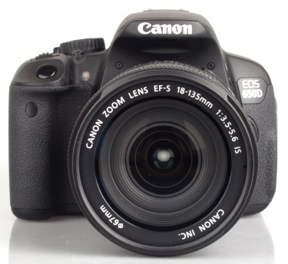
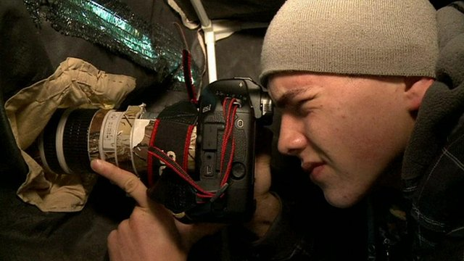


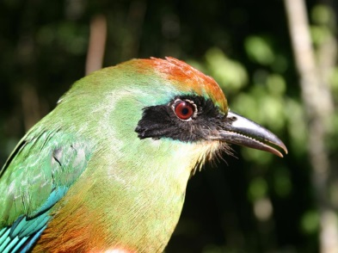

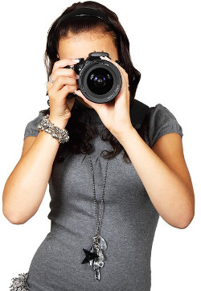
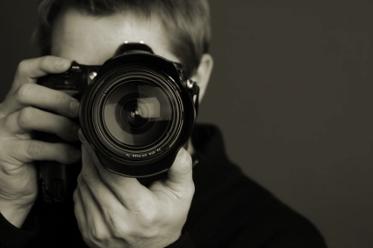
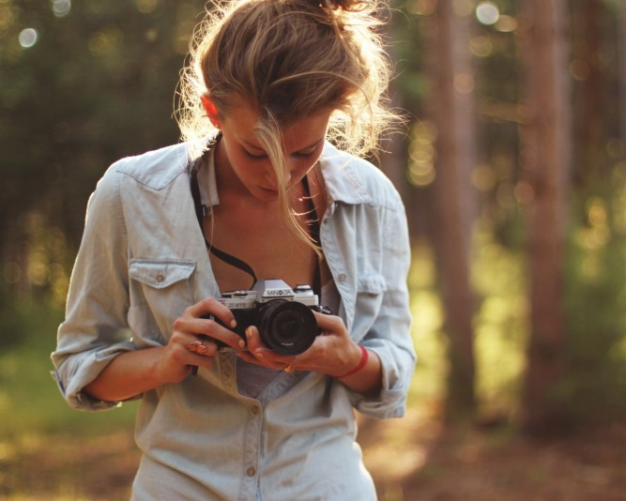
MoodBoard

Slide 3
Brief
I discovered that people who generally use DSLR cameras, such as the ones within Canon’s range, ranged from young to old. However younger people have been taking a severe interest throughout the years and are perhaps even over-taking their elder counterpart
People that use DSLR cameras usually take their work very seriously. They have to if they are willing to spend a lot of money, hundreds to even thousands sometimes, on the product. This usually encourages them to have a very outgoing, artistic and positive nature to things, as they need this attitude when out and about shooting
Therefore I chose to use brighter and more vibrant colours to appeal to them as my target audience, and I believe this will attract all photographers no matter the age.

Slide 4
I chose to model my point of sales display in 3DS Max, and to do so after the shape of a film strip. It is a very subtle appearance to one, but I believe it aesthetically looks rather nice as it represents itself boldly.
I chose to model a massive statue of a DSLR camera in the middle of the display as I believed this would really stand out and catch people’s attention.
The actual items can be grabbed from on top and below the display
I added a skeleton figure to represent the average height of a man, so that we can see how tall a person would stand next to the display.

Slide 5

